Slide 1

Smart office networking system
Automated smart office
1

Slide 2
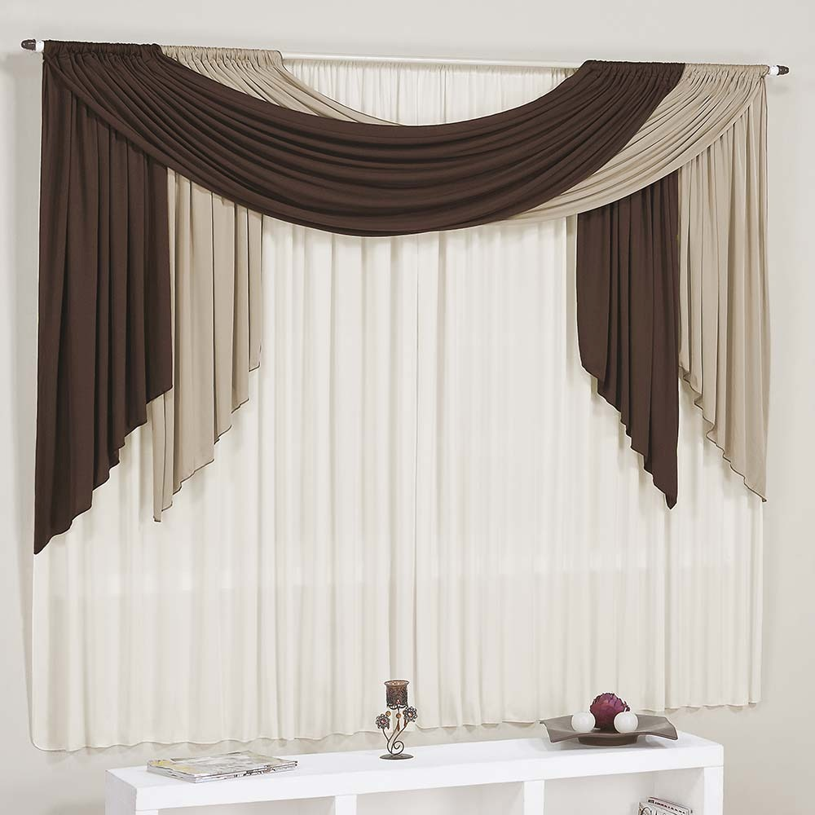

Group Members CSEC399 (A)
1. NUSRAT JAHAN BITHI ID:2192081026 2. TONIMA AKTER ID:2191081017
3. ISRAT JAHAN SATHI ID:2192081027
4. AMIT HASAN ID:2192081017
Supervisor: Ratul Sikder
Coordinator: MD. Torikul Rahman
2

Slide 3
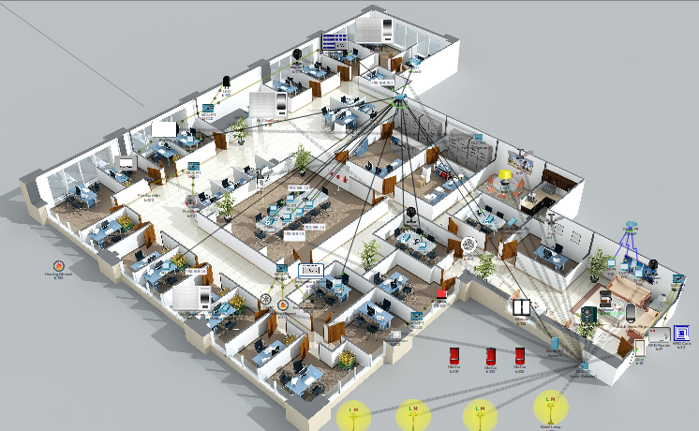
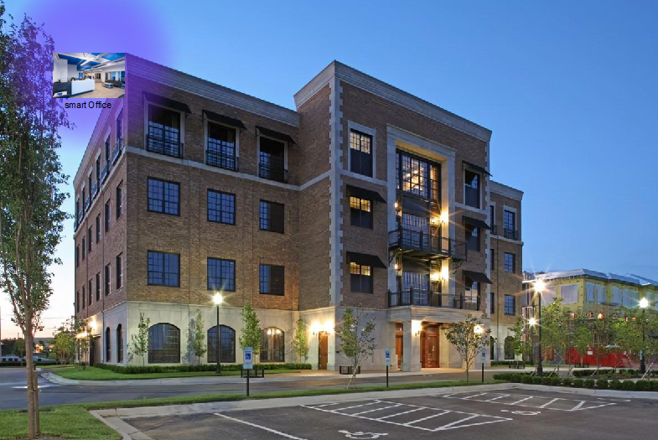
Video slide
Project desing:
Smart Office

Slide 4
Agenda
Introduction
01
Background Study
02
Project Methodology
03
Possible Outcome
04
Expected Outcome.
05
Conclusion
06

Slide 5


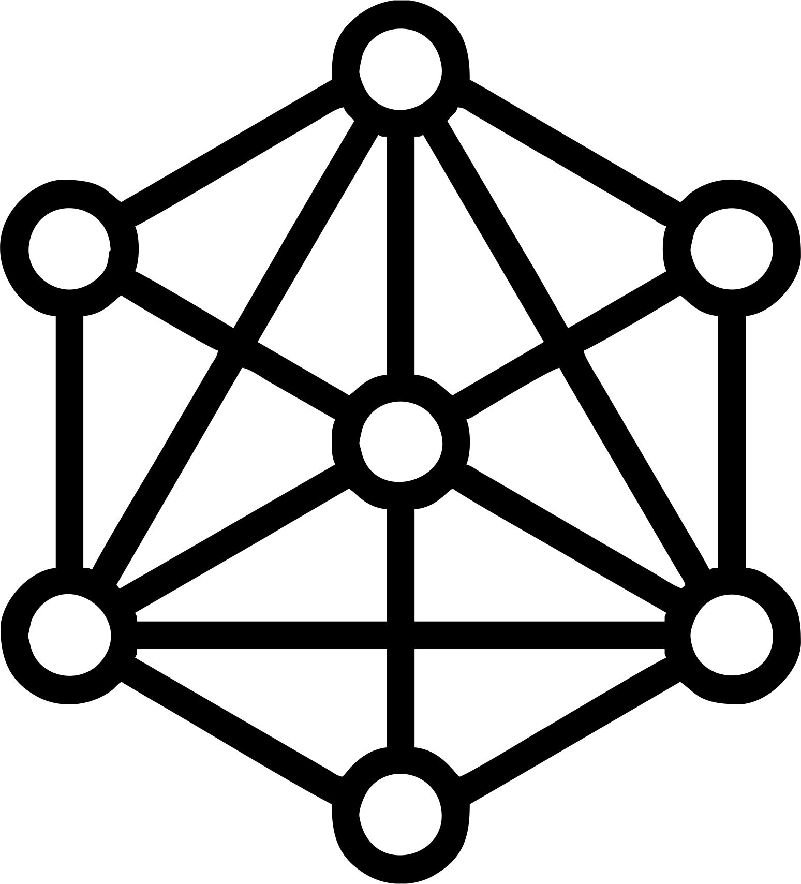



Introduction
IOT
“things”—that are embedded with sensors, software, and other technologies for the purpose of connecting and exchanging data with other devices and systems over the internet.
Network Sequrity
Is a type which secure the data .
Smart Office
A smart office is a workplace where modern technology is leveraged to help employees work smarter, better, and faster
Computer Networking
Computer networking refers to connected computing devices and an ever-expanding array of IoT devices that communication with one another.
LAN
Local Area Network is a collection of devices connection together in one physical location

Slide 6
Objectives:
Part 1: Add Home Gateway to the Network.
Part 2: Connect IoT Devices to the Wireless Network.
Part 3: Sequrity System.
Part 4: Add End User Device to the Network.

Slide 7

INTEL SRR3
0101
SRR3, the 628,000-square-foot, nine-story office building is 48 percent more energy efficient than other like buildings, produces 70potential to save over 12 million gallons (MGY) of potable water annuallypercent less greenhouseGHG) emissions and has the potential to save over 12 million gallons (MGY) of potable water annually.
Background Study
02
High Voltage Pvt.Ltd
Smart office include fingerprint regognation,smart light,Fire Alert etc.
03
Dhaka Stock Exchange
They have strict sequrity system. Fingerprint ,smart id card are the one of the option to verified the person .

Slide 8
Model Selection
1
Requrement Analysis
As a Project team we will choose SDLC Model.
logical and physical model
Implementation design
2
The task can be frequently changes are required on client demand .
IoT software design and development is the process of creating centralized networks that interconnect devices using wireless technologies (such as Wi-Fi, Bluetooth,smartphone etc.) without human intervention
3. Anytime changes are acceptable.
4. Time limit 12 months.
3
Coding and testing
improving
4
Review
SDLC models

Slide 9

PROJECT TIMELINES – GANTT CHART
MAY | JUN | JULY | AUG | SEP | OCT | NOV | DEC | JAN | FEB | MAR | APR
coding
Completion of publishing the document template
Tasks 8
Tasks 3
Tasks 6
Testing and improving.
Tasks 10
Tasks 2
Tasks 5
logical and physical model implementation
Process layout design
Tasks 4
Tasks 9
Full designing
Tasks 7
Completion of checking and reviewing the overall documents
Tasks 1
.
prepare proposal & presentation
.
Selecting Idea.
Investigation of problem
And meeting analysis of problem

Slide 10

Why is IoT Important?
As IoT grows exponentially year on year, companies are leveraging the tremendous business values it can offer. Here are some of the most important benefits of IoT:
To generate new business models and revenue streams
To improve business decisions through data-driven insights from IoT data.
To increase productivity and efficiency of business operations
To enhance customer experience.

Slide 11
How an IoT boost smart office efficiency?
Energy Consumtion
IoT manages to makes office spaces smart enough to detect a change in a certain space and automatically puts off appliances that are not in us.
Conditioned Climate
IoT also manages to regulate the temperature of the workspace by estimating the ideal requirement.
Safer Workspace
Installation of safety cameras, sensors, and access control systems ensure that the device you are using is safe from malware and any sort of informational theft.
Space Manegment
Owing to IoT’s ability to store tons and tons of data, your workspace becomes a paperless environment.
Resource Management
IoT allows the determination of patterns and devices algorithms that perform the tasks faster.

Slide 12
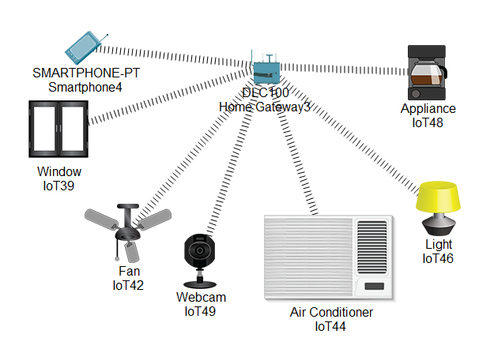
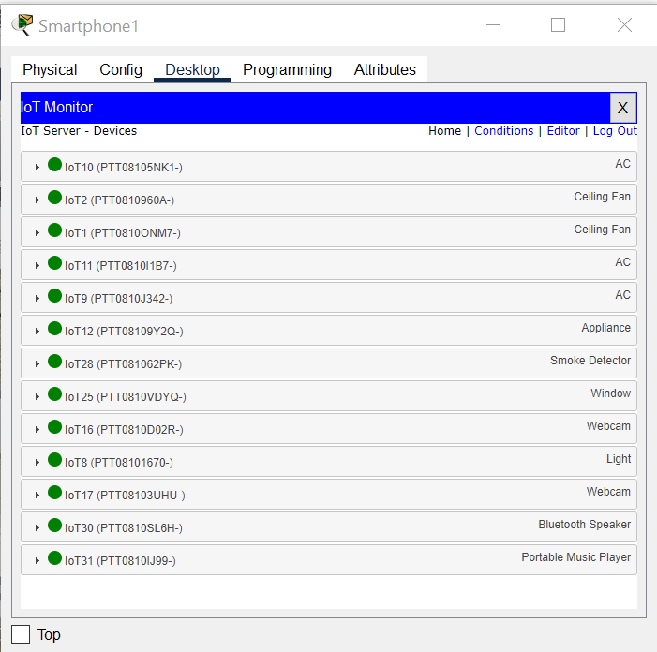
Using IoT
Wireless0 has to be selected to enter SSID of home gateway.
This to indicate that the device connected to the office
USING IOT
9

Slide 13
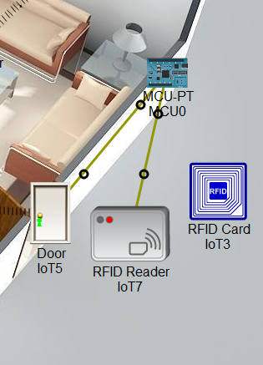
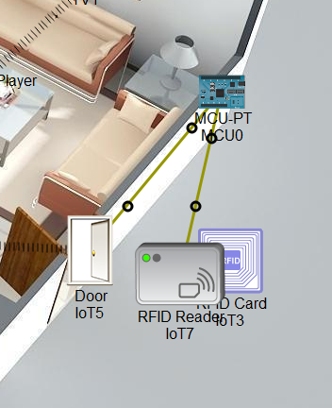
RFID based Door Lock
RFID Based Door Lock:
1. Door can be unlocked only by using valid RFID card.
If anyone wants to enter in the office, he or she has to show RFID.
3. If the RFID is valid, the door will be opened, otherwise not.
RFID based Door Lock

Slide 14
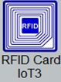
RFID READER
RFID READER
RFID based Door Lock
5

Slide 15
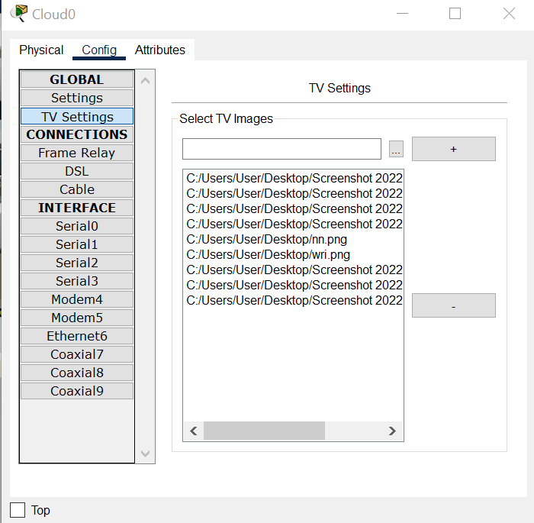
Cisco Cloud Fusion for Videoscape
1. which allows service providers to mix-and-match elements of all Videoscape
deployment modes – cloud software, cloud services, or on optimized hardware
and software
Cloud-pt
6

Slide 16
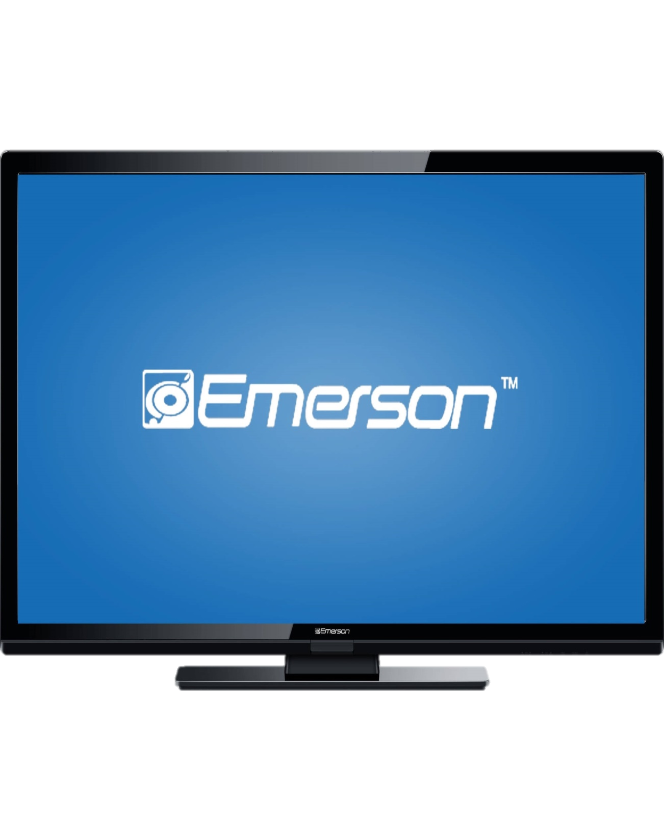
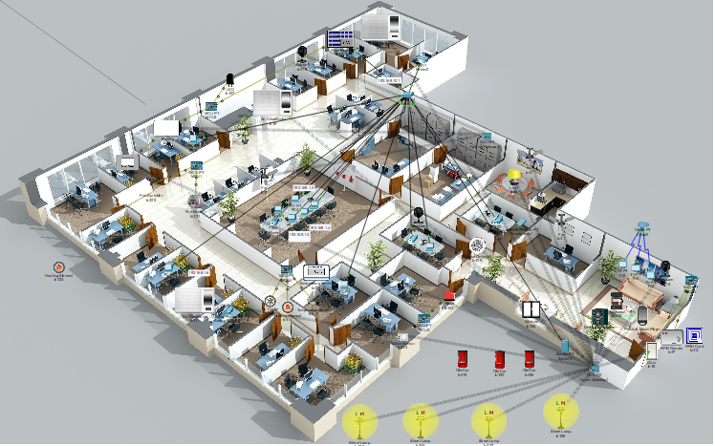
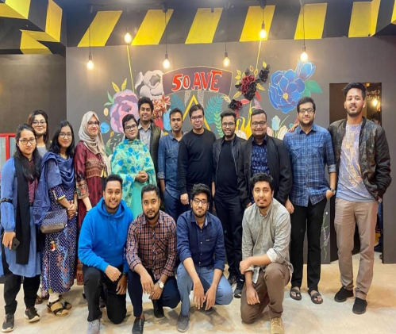
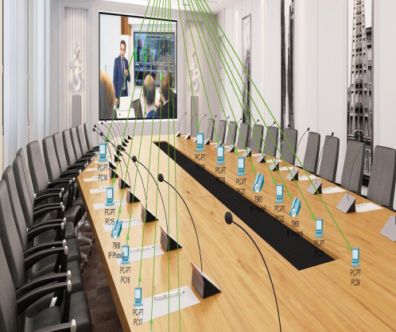

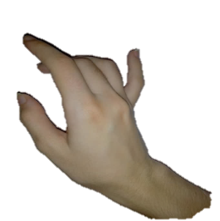
Cloud-pt
off
on
TV
7

Slide 17
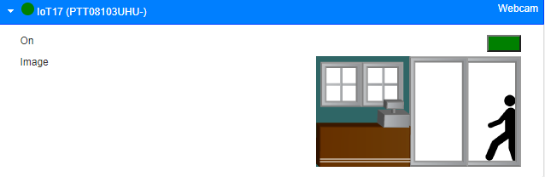
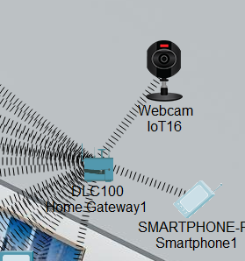

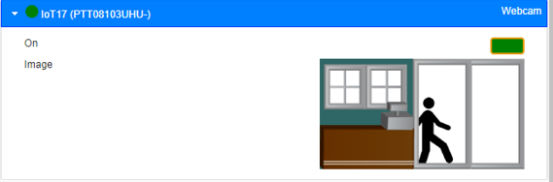

webcam
Webcam:
1. When the smartphone icon is clicked, the configuration webcam appears.
2. The SSID from Wireless0 has to be updated with home gateway instead of
default and it leads to automated IP address for the smartphone.
WEBCAM

Slide 18
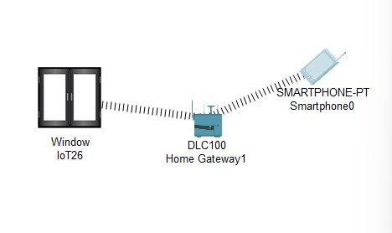
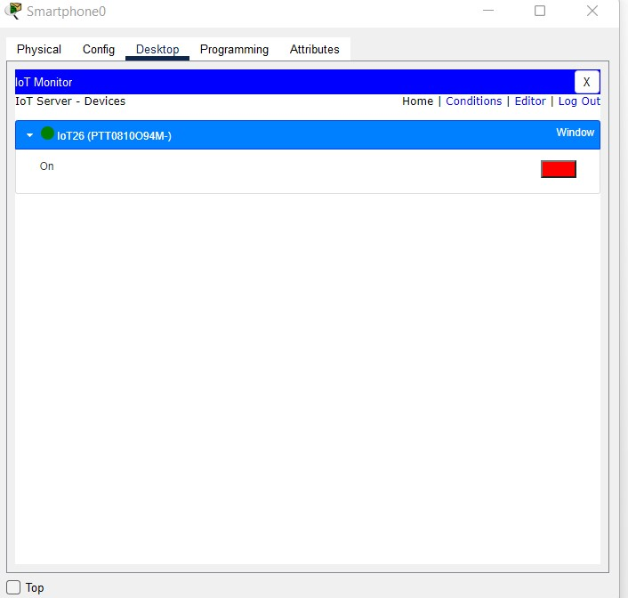
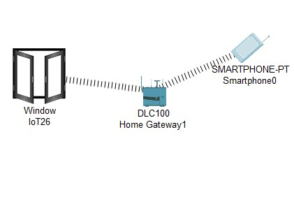
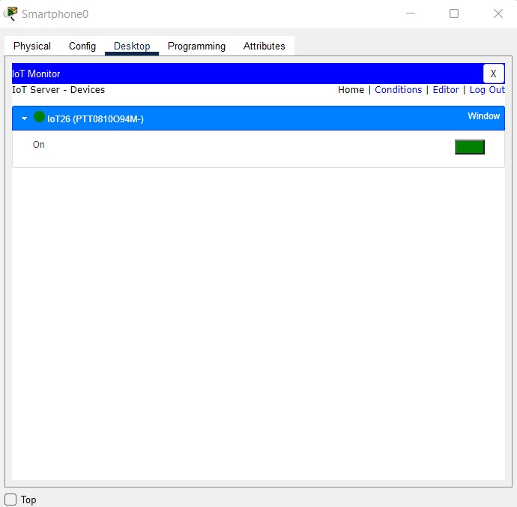
The next step is to connect the smart phone to the home gateway.
2. Select the device type from the end devices
selection box. When the smartphone icon is clicked, the configuration window appears.
The SSID from Wireless0 has to be updated with home gateway instead of default and it
leads to automated IP address for the smartphone.
smart window

Slide 19
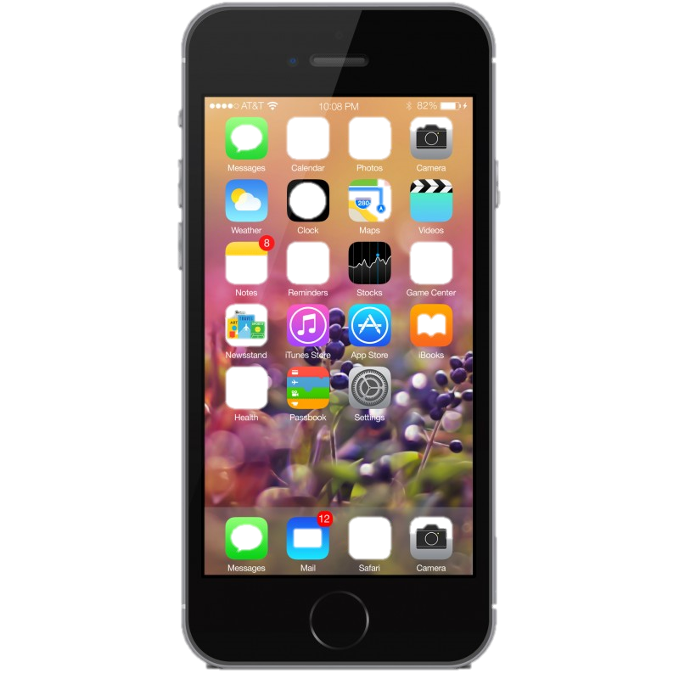
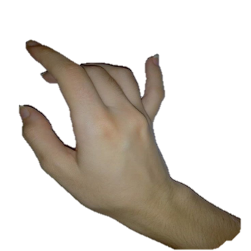
Smart window
15

Slide 20




Expected outcome
Improve Employess Satisfaction
Fire Alert,Time saving 3
Power Saving 1
Smart Rfid 4

Slide 21
possible outcome:
When the smart office are at their best when
their lives will be the best too.
However, in order to make your office smart,
the application of IoT is necessary as it helps the
owner to control and supervise their lights, ac,
fans, windrow ,door lock,webcam security and
other office devices through any of their
smartphone devices.
In short, a smart office is a modern
technological experience that will help the
owners save their money,
time, and energy spent on their daily-life.

Slide 22
conclusion:
IoT is the new trendsetter in today’s world due to its amazing and advanced applications which makes life easier for both individuals and entrepreneurs. With such demand, the scope of IoT in the upcoming days will also be more as there will be more smart homes , smart office, retails, and cities.
Each application of IoT will be in great use and the demand will be more as well IoT along with AI will also be advanced as new scopes, markets, and applications like 5G networks, will be edged too and all of this will lead to a better economy and a fast-evolving lifestyle.

Slide 23
Thank you

